Slide 1


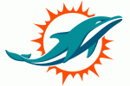






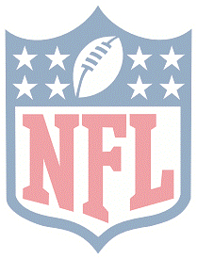
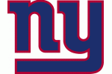


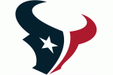
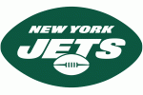


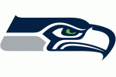
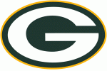




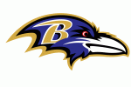



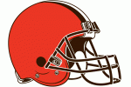





Project 1:
Any Given Team
Parley Partners

Slide 2
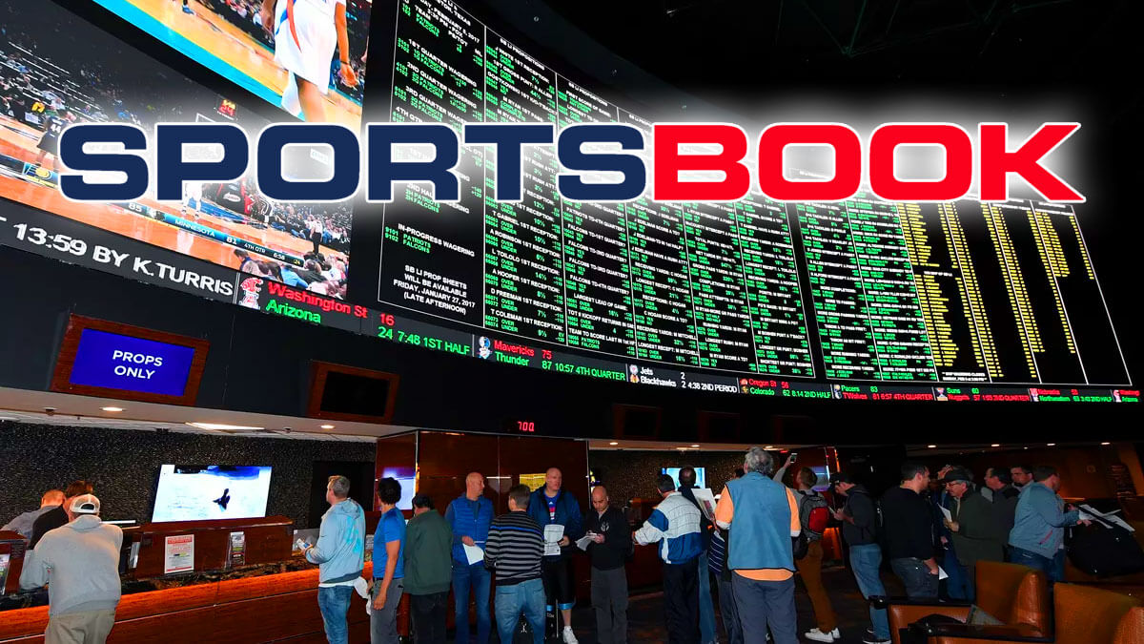
Analytics
About 60% of Americans identify as a sports fan
59.3 million play fantasy sports games with fantasy football being the most popular
NGCB(Nevada Gaming Control Board) reported $300 million in revenue at an average 6% house take. This equates to roughly $5 billion in annual handle.

Slide 3
Our Audience

Slide 4
User Story
Let’s the user make a soft bet with a friend on any given team

Slide 5
DEMO

Slide 6
What we did…

Slide 7
Potential Revisions

